Slide 1
Utah’s Homeless Approach
Denver Tour Group Lloyd S. Pendleton
Salt Lake Leadership Exchange Former Director Utah
September 23, 2016 Homeless Task Force

Slide 2
Homeless Homed -- The Daily Show
With Jon Stewart
http://thedailyshow.cc.com/videos/lntv3q/the-homeless-homed

Slide 3
Thank You

Slide 4
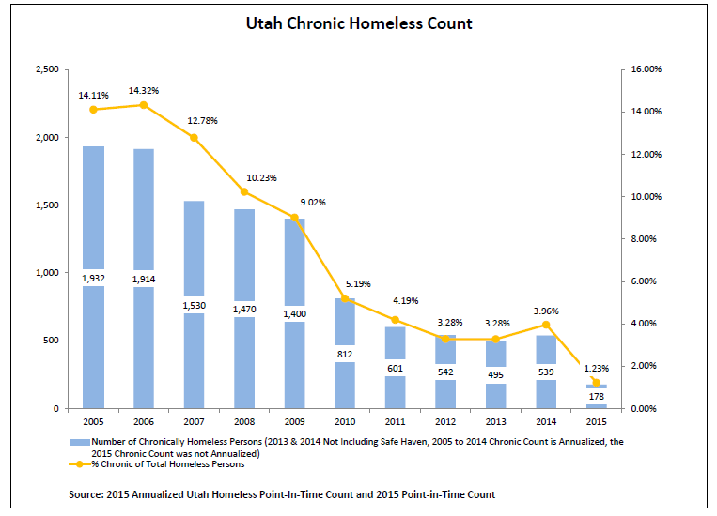

Slide 5
Why the Success in Utah?
Champions for homeless citizens
Collaboration among homeless service providers, funders, political leaders in cities, counties, and state
Compassion for providing viable housing opportunities and services for our homeless citizens

Slide 6
Champions

Slide 7
Characteristics of a Champion
Energy – Begins and finishes projects
  Stamina & staying power
  Enthusiasm & optimism
  Sense of humor
Bias to Act – Solve problems not decry them
  Focus on solutions
  Sense of urgency
  Opportunity driven

Slide 8
Champions -- Continued
Results Oriented – Outcome, not process matters most. Networking & capacity building are the means, not the end
  Need for achievement
  Clear & compelling vision for success
  Chart & use milestones

Slide 9
Champions -- Continued
Personal Responsibility – Take responsibility for their own their behavior
Belief in Common Good – Look beyond what is good for their families & friends
  See & feel impacts on others
  Builds on diversity
  Activate shared values

Slide 10
Champions -- Continued
Inclined to Teams – Provide the juice, but know they need an engine
  Form teams from different, not like-mined
  Share credit as well as information
  Seek creation, not agreement

Slide 11
Collaboration

Slide 12
“Men build too many walls and not enough bridges.”
Sir Isaac Newton

Slide 13
Vision Statement
Vision – A function of the heart
  “Where there is no vison, the people perish” Proverbs 29:18
Statement – All homeless Citizens achieve maximum integration into society
  Write vision for -- not against
  Housing a major step in process, not end
  Keeping housed key
  King’s Dream speech

Slide 14
“No problem can be solved from the same consciousness that created it. You must learn to see the world anew”
Albert Einstein

Slide 15
State of Utah Vision
Everyone has access to safe, decent, affordable housing with the needed resources and supports for self-sufficiency and well being.

Slide 16
Stakeholders
Need to be at Table:
Champions | Political Leaders
Funders | Housing Authorities
Business Leaders | Faith Based Leaders
Homeless Service Providers | Public Safety Leaders (police, etc.)
Formerly Homeless Citizens | Community Leaders
Advocates | State/County/City Staff

Slide 17
Homeless Committee
Needs to be above the “silos”
Members have authority to implement decisions
Not too large
Have authority over some of the homeless funding

Slide 18
Compassion

Slide 19
“In everyone’s life, at some time, our inner fire goes out. It is then burst into flames by an encounter with another human being.”
Albert Schweitzer

Slide 20
Who Are the Homeless?
Citizens of our communities
People suffering and in need of hope
Bigger picture – brothers & sisters

Slide 21
I chose the road less traveled and now I don’t know where the hell I am.

Slide 22
National Effort

Slide 23
National Effort on Chronic and Veteran Homelessness
10% homeless population chronic
Chronic Definition -- Unaccompanied adult with a disabling condition homeless a year or more or four times in three years
10-14% homeless population veterans
End veterans homelessness by 2015
End chronic homelessness by 2015 (Initial date)

Slide 24
Cost of Homelessness
Chronic homeless individuals have emergency services costs such as:
  Emergency rooms visits to hospitals
  Transportation to hospitals
  Jail time
$48,792 per person (JAMA 4/1/09)
$40,449 per person (Culhane NY, NY study)
$35,949 per person (San Diego Serial Inebriate study)

Slide 25
LA County Study (Jan, 2016)
Study of 148,815 homeless individuals fiscal year 2014-15
Reviewed cost of six County Departments (Health Services, Mental Health, Public Health, Public Social Services, Sheriff, Probation)
Total homeless cost $964.5 million
Top 5% (7,441) cost $381.2 million or $51,227 per person

Slide 26
Utah – Chronic Homelessness Housing Opportunities End of 2015
One Salt Lake person’s 2010 ER costs were $563,000
One over 3 years was $937,744

Slide 27
Utah’s Approach

Slide 28
Homeless Coordinating Committee
Jon Pierpont Dept. of Workforce Services
Spencer Cox Lt. Governor Chair
Gordon Walker Housing and Community Development Division
Dr. David Patton Department of Health
Bill Crim Businesses/United Way
Craig Burr Dept. of Corrections
Al Hernandez Veterans’ Admin.
MISSION
Gina Ramer
Social Security Denver Office
Formerly Homeless
End Chronic Homelessness and
Reduce overall Homelessness by 2014
Financial Institutions
Pamela Atkinson At Large
Max Lang Office of Education
Terry Feveryer S.L. Housing Authority
Lana Stohl Dept. of Human Services (DHS)
Jonathan Hanks Utah Housing Corporation
Mike Gallegos Local Governments
Jane Lewis Balance of State Continuum of Care
Philanthropic Orgs.
Tara Rollins SLC Cont. of Care
Ron Humphries Faith Based Orgs.
Bill Hulterstrom Mountainland Cont. of Care
February 2012

Slide 29
Homeless Coordinating Committee Organization
Lt. Governor Greg Bell
Allocation Committee
HCC
Discharge Planning
Affordable Housing
Supportive Services
Information Systems
Local Homeless Coordinating Committees
Lana Stohl
Craig Burr
Gordon Walker
DWS/HMIS
Bill Crim
JoAnn Seghini
Mental Health
Substance Abuse
Foster Care
Juvenile Justice
Banks
Developers
Housing Authorities
Planners
Providers
Domestic Violence
Case Management
Training
Employment
HMIS
Outcome Measures
Management Reports
Prisons
Jails
Elected Officials
Chair - LHCC
Tooele
COG
Salt Lake County COG
Bear River AOG
Five-County AOG
Mountainland AOG
Six-County AOG
Grand County COG
San Juan County COG
Carbon/
Emery
COG
Uintah Basin AOG
Davis County COG
Weber County COG
COG – Council of Governments
AOG – Association of Governments
October 2013

Slide 30
AOG/COG Homeless Coordinating Committee (Model)
Elected Official Chair
Dept. of Human Services
Vice-Chair
Businesses
Dept. of Health
Financial Institutions
Dept. of Corrections
Purpose
United Way
Dept. Workforce Ser.
  Implement local ten-year plan in providing housing opportunities to all chronically homelessness individuals and reduce overall homelessness by 2014.
Housing Authorities
At Large
Sheriff
Formerly
Homeless
Community Clinics
Domestic Violence
Schools/PTA
Service Agencies
Colleges/Tech. Schools
Continuum of Care
Local Government Leaders
Native America Housing Authority
Faith Based Orgs.
Police Chief

Slide 31


Local Homeless Implementation Plan
Funding
•
State
(PAHTF, CNH,
State 10
-
Year Plan
ESG, OWLF,CIB)
State
•
Private
Committees
•
Federal
Actions
Ø
Block Grants
(CSBG, CDBG,
Political Leader Chair
Housing
•
Homeless
SAPTBG, MHBG).
•
Coordinating
Ø
Entitlements
(SSI,SSDI, DBA
Vets)
-
Local
•
Reduce D V
Committee
Ø
Mainstream
Homeless
•
Prevention
Programs (Food
Ø
Discharge
stamps, SCHIP,
TANF, Section 8,
Coordinating
•
Employment
Planning
Home, DVA,
Public/Indian
Committee
•
Income Support
Ø
Affordable
Housing)
Housing
Ø
Homeless Targeted
Discharge
Programs (Cont. of
•
Ø
Supportive
Care, Health Care,
Planning
PATH, Employment,
Services
Surplus Property,
etc.)
*
•
HMIS/Outcome
Ø
Information
Measures
Systems
HUD
REQUIREMENTS
•
Transportation
•
Consolidated
•
Supportive
Housing Plan
Local 10
-
Year
Service
•
Continuum of Care
Plan
•
Health Care
Annual Strategies
•
Other
*
Education (DOE), Homeless Vets
–
Transitional Housing (DVA), Treatment for the Homeless
(SAMHSA), Runaway (AFC/DHHS)
January 28, 2008

Slide 32
Ben Nickle
St. George Council Member

Slide 33
How is homelessness ended?

Slide 34
Affordable Housing
Housing First

Slide 35
Housing First Principles
Move people into housing directly from streets and shelters without preconditions of treatment acceptance or compliance
Provider is obligated to bring robust non-coercive support services to the housing
Continued tenancy is not dependent on participation in services
Units are targeted to the most vulnerable homeless members of the community

Slide 36
Housing First – Utah Pilot
We had heard about the Housing First concept developed in New York City
Would it work in Utah?
2005 pilot of the most difficult (17) to test it while a 100 unit facility was constructed
We became believers, especially case managers
Now operate with belief “all can be housed”

Slide 37
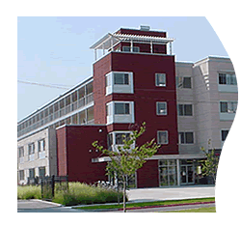
Sunrise Metro (100 units) – April 2007
Project Partners
Utah Division of Housing and Community Development
Salt Lake City
Salt Lake County
Crusade for the Homeless (Private Foundation)
George S. and Dolores Dore Eccles Foundation
Church of Jesus Christ of Latter Day Saints
Utah Housing Corporation
American Express

Slide 38
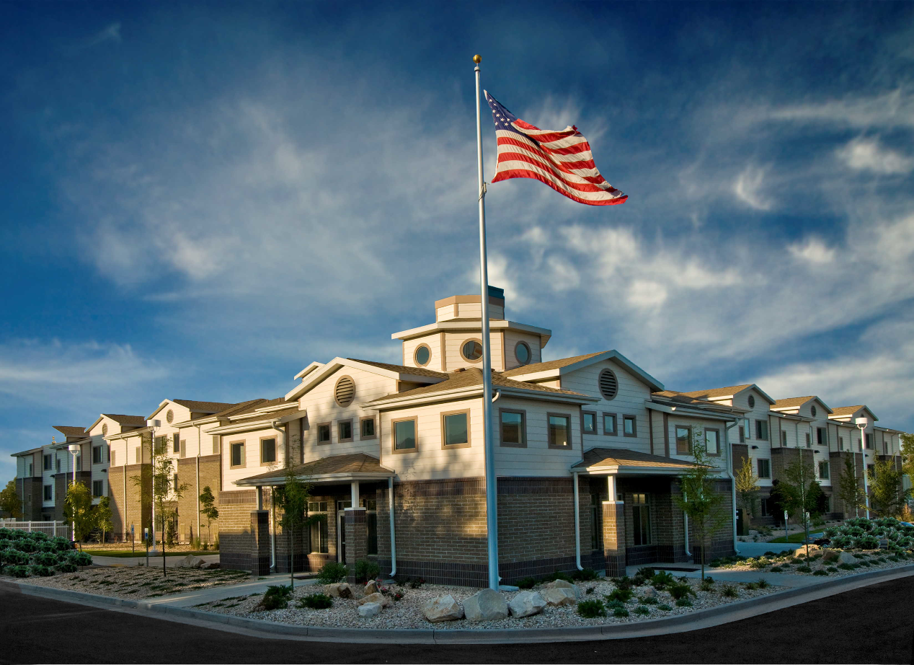
Grace Mary Manor (84 units) – April 2008

Slide 39
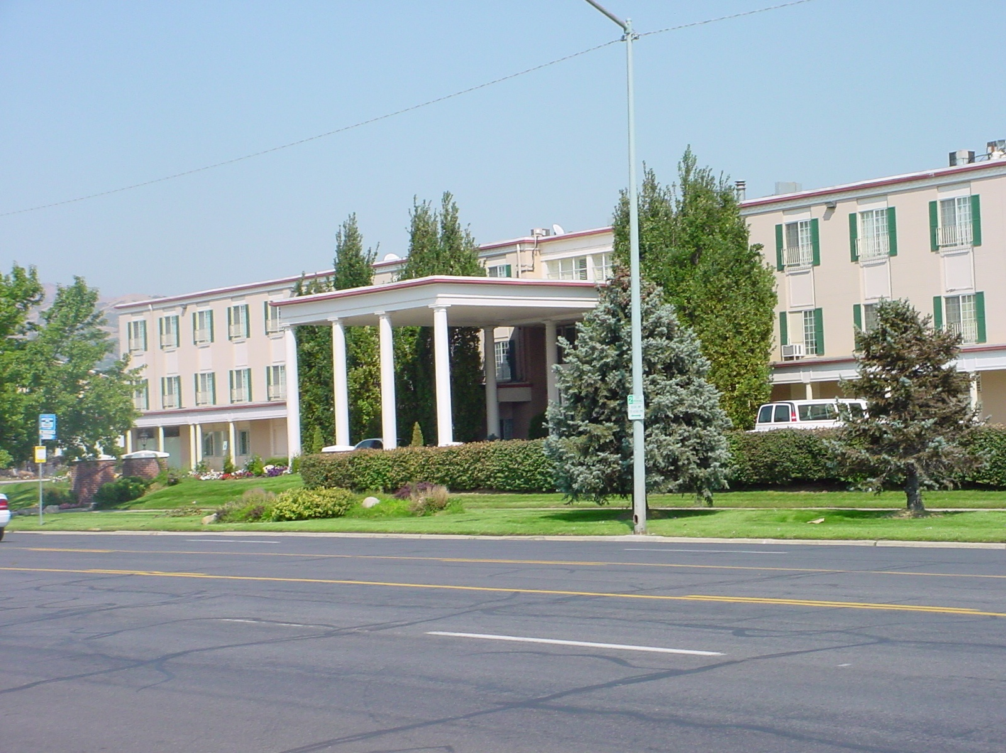
Palmer Court (201 Units) – May 2009

Slide 40
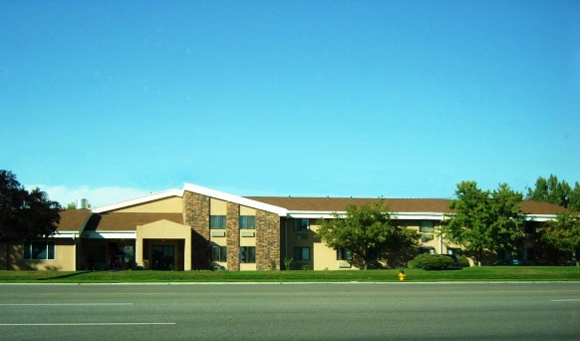
Freedom Landing
Homeless Veterans (110 Units) -- Jan. 2010

Slide 41
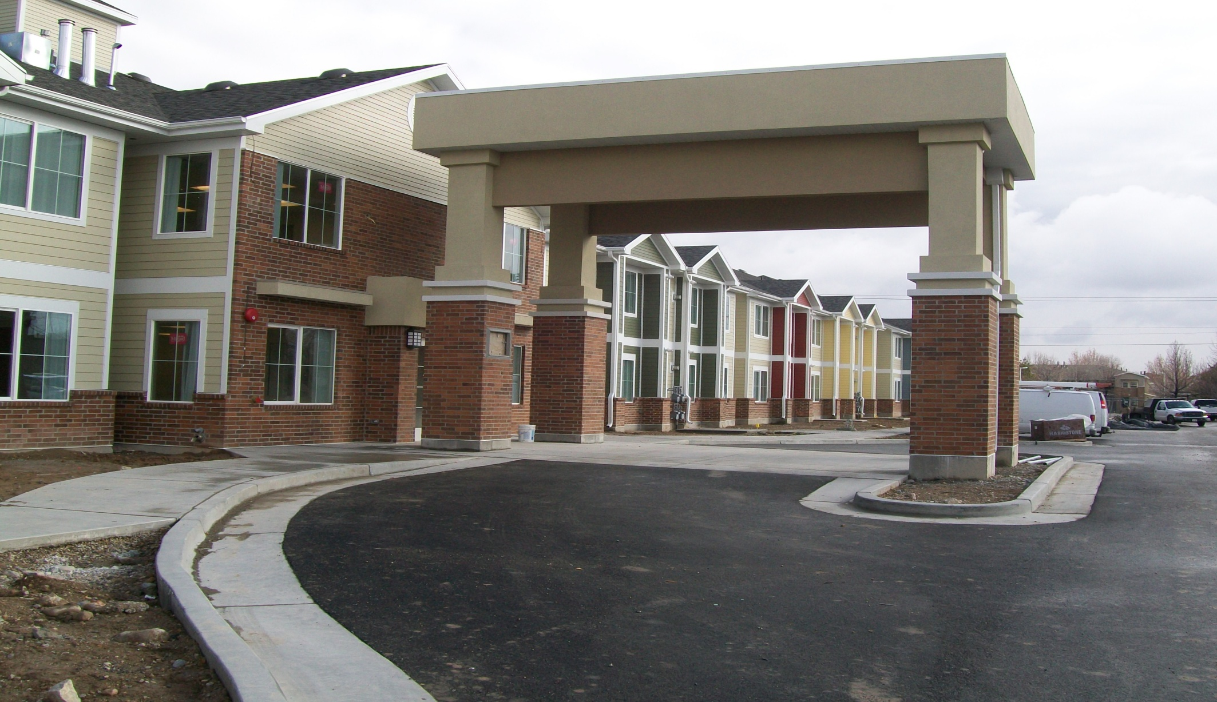
Kelly Benson 55 and Older Homeless - June 2010 (59 Units, 70 Beds)

Slide 42
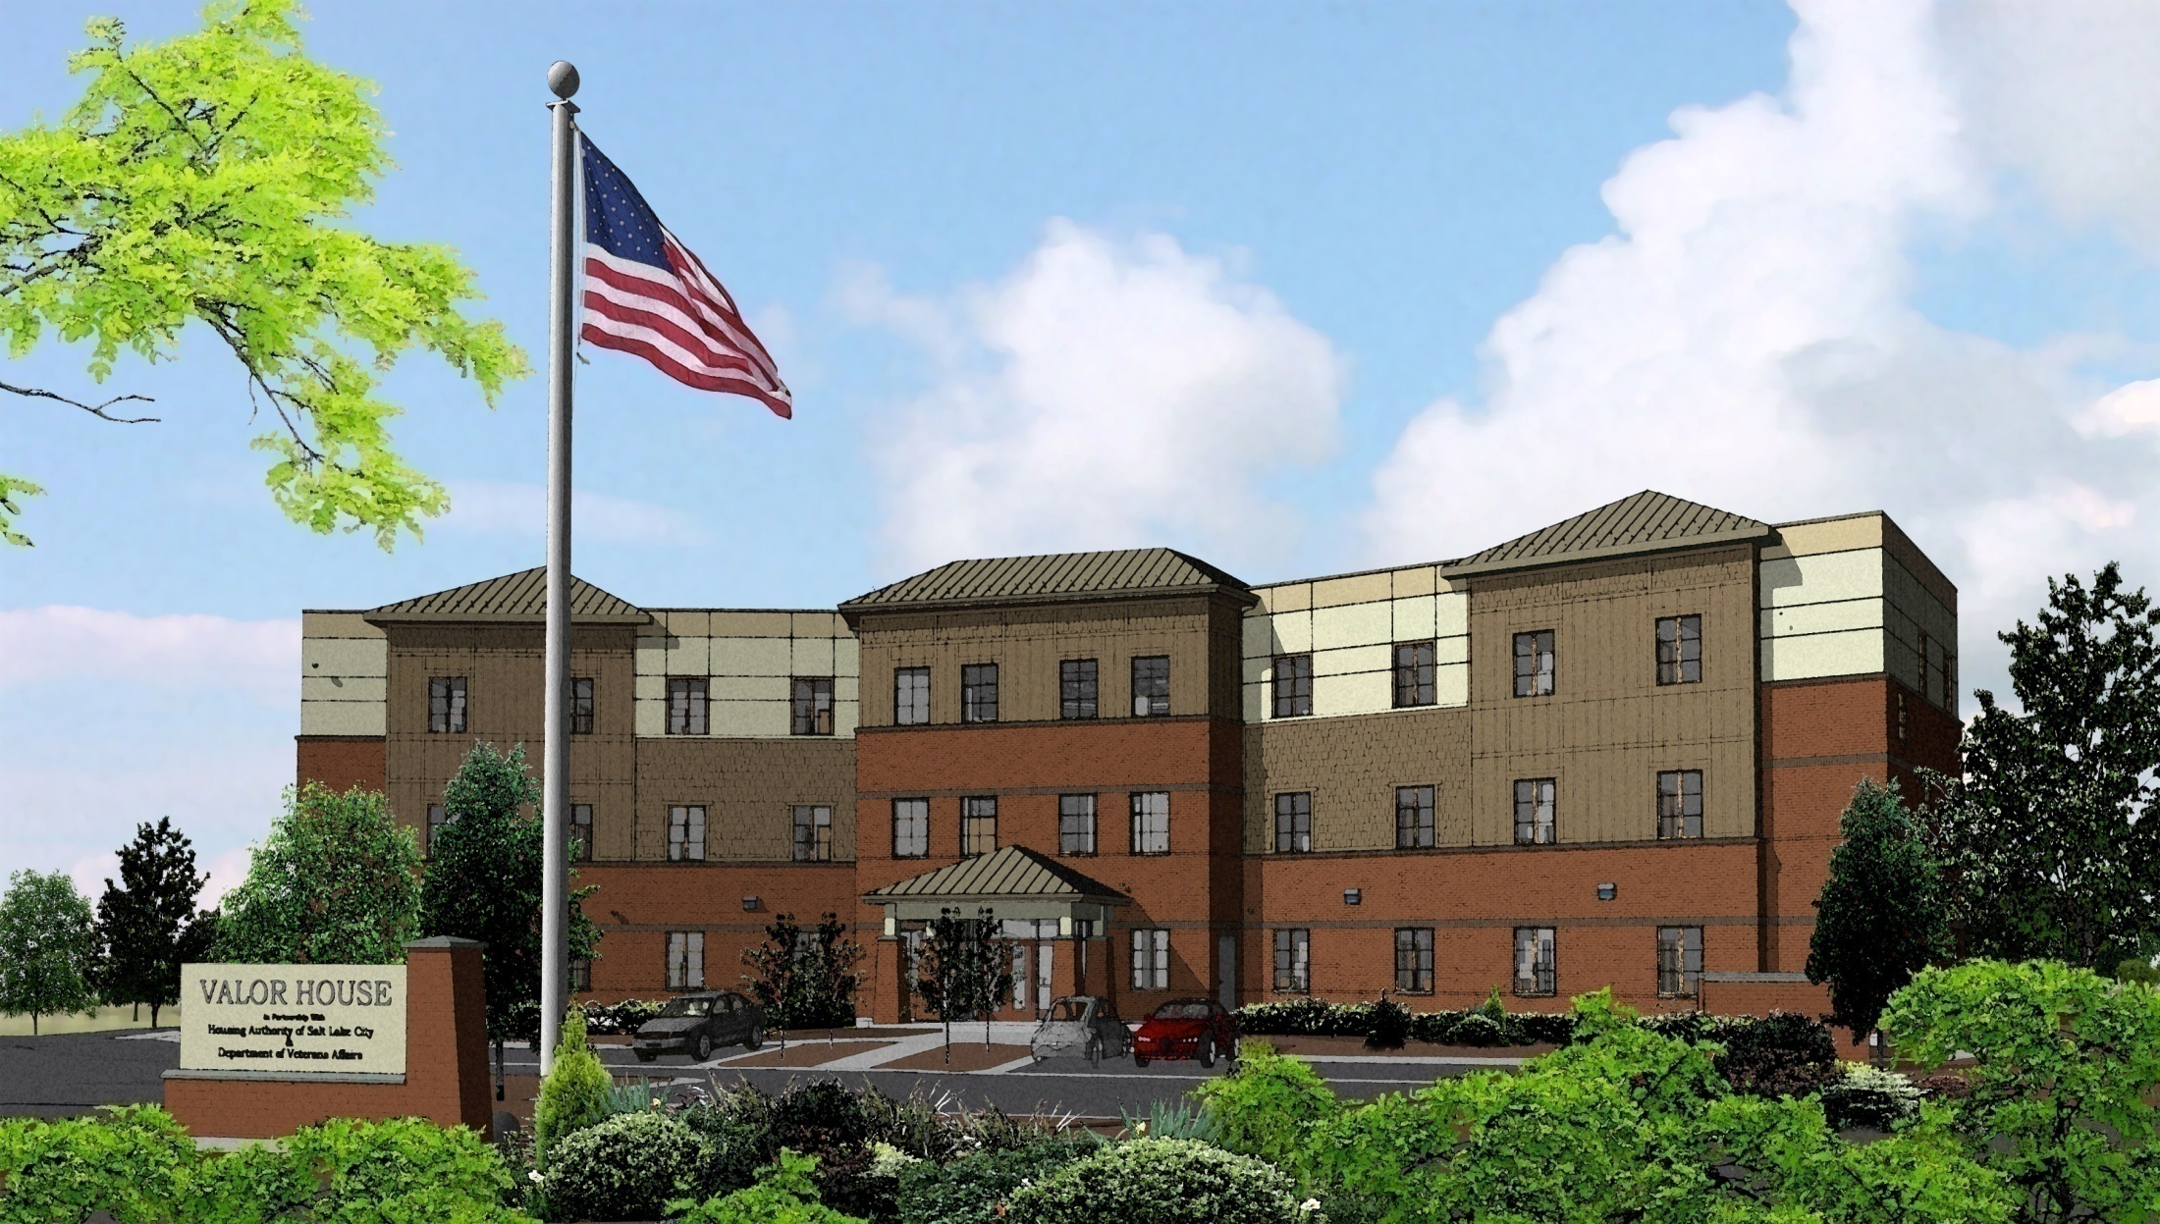

Slide 43
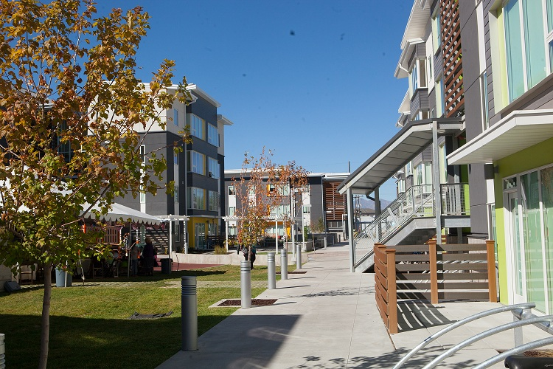
Bud Bailey Apartments – 134 Units

Slide 44
Homeless Funding
State Homeless Trust Fund
  Tax check off donation by public
  Line item from general funds
Tax Credit Finance Organization gave priority for permanent supportive housing
State Housing Trust Fund
HOME and CDBG funds

Slide 45
Homeless Funding -- Continued
Crusade for the Homeless Fund
  Significant business leader supported PSH
Pay for Success funding
  Project implementation paid for by philanthropy and/or commercial impact lenders
  Government pays the lender as the project achieves the goals of reducing government costs

Slide 46

When your vision is crystal clear, taking action happens naturally.
Thomas F. Crum, “The Magic of Conflict”

