Slide 1
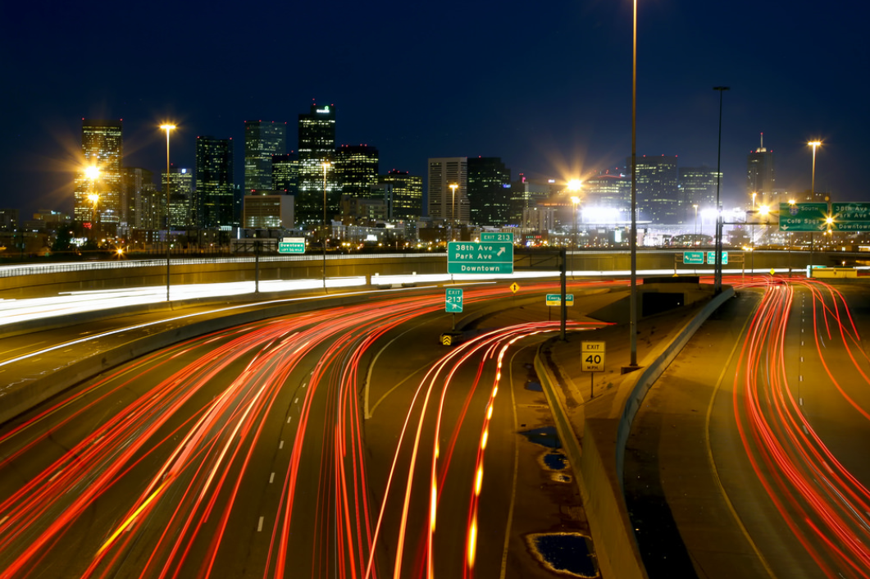
Impact Denver
July 26, 2016

Slide 2
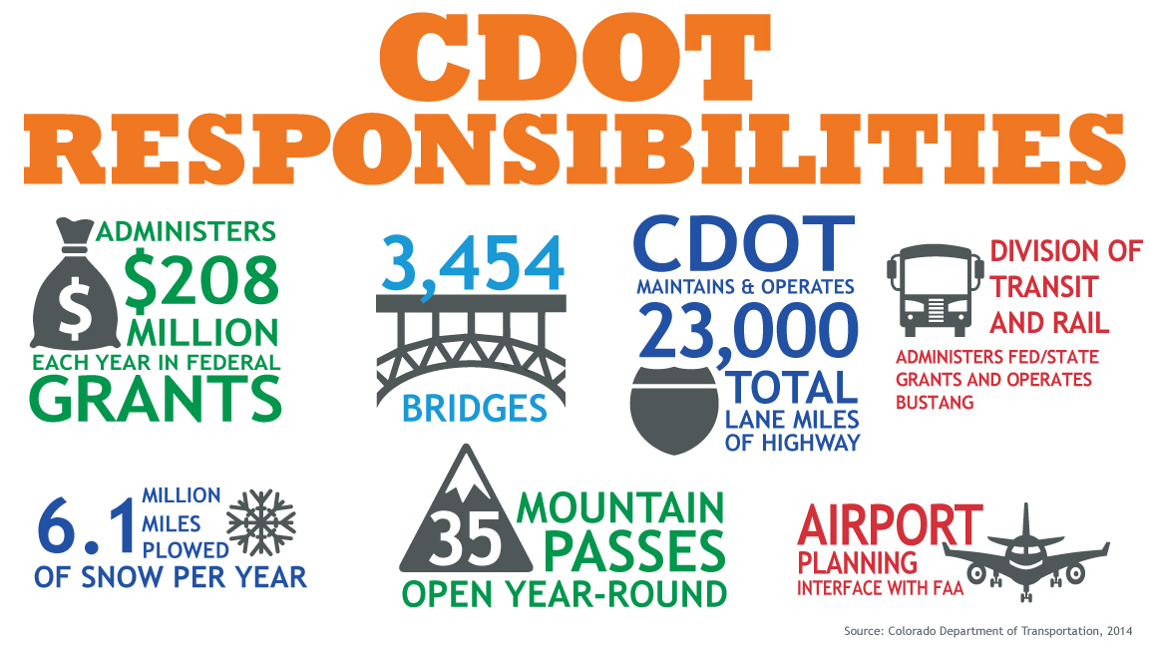
$1.43 BILLION BUDGET
Notes:
NOTES:
Slide shows just a few of CDOT’s responsibilities- (NOTE TO SHAILEN: no need to go through details, but you can pause here and tell your story of your 1,100 mile, 3-day tour, and the R4 maintenance guy joking about how many snow plows Delaware has- this would be a good time to tell that story if you didn’t tell it during confirmation.)

Slide 3
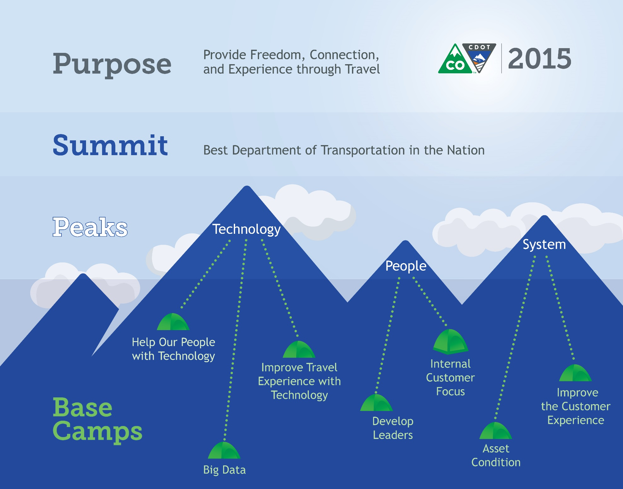
healthy
Notes:
NOTES
CDOT’s goal is to be the best DOT in the country.
How we get there is by focusing on our customers and by integrating new, creative approaches into how we have traditionally done business.

Slide 4
THEN AND NOW
per capita spending
1991
vs.
2015
population
3.3 million
5.4 million
vehicle
miles
traveled
27.7 billion
vehicles miles traveled
49.3 billion
vehicle miles traveled
$$$$$$$$$$$$$$$$$$$$$$$$$$$$$$$$$$$$$$$$$$$$$$$$$$$$$$$$$$$$$$$$$$$$$$$$$$$$$$$$$$$$$$$$$$$$$$$$$$$$$$$$$$$$$$$$$$$$$$$$$$$$$$$
dollars
spent/person
$$$$$$$$$$$$$$$$$$$$$$$$$$$$$$$$$$$$$$$$$$$$$$$$$$$$$$$$$$$$$$$$$$$$
$125.70/person
$68.94/person
All dollar figures adjusted for inflation
Notes:
This is kind of our starting point- what has happened since 1991 (the last time the state gas tax was increased). Even with ongoing efforts to create and implement efficiencies CDOT continues to fall behind. This slide helps illustrate why.
CO Population projections:
Currently 2015: 5,439,000
Future 2040: 7,752,000
Increase = +2,313,000

Slide 5
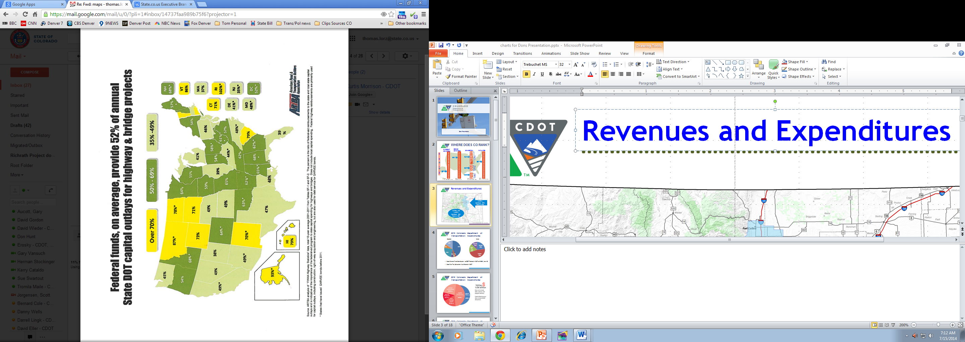
FUNDING AND BUDGET
use $2 federal for every $1 state
Notes:
This slide shows the ratio of state vs federal funds used in DOT capital construction projects- Colorado relies on federal funds more than most neighboring states.
2 of every 3 capital construction dollars comes from the federal government.
As the federal government continues the debate over how to fund the nation’s infrastructure
States are left with uncertainty on whether we can rely on federal funds
Many states around Colorado have raised gas or other taxes to fund transportation.
Utah is a good one to call out here- they have an inverse ratio, where nearly 2/3 of their construction budget is state dollars, and they are a prime competitor for new jobs and tourism dollars. They have “figured it out”

Slide 6
WHERE DOES COLORADO RANK?
PAVEMENT
CONDITION
BRIDGE
CONDITION
SYSTEM
RELIABILITY
FATALITIES
BIKE
FRIENDLY
TRANSIT
UTILIZATION
SCALE: BEST to WORST
(2015) 7th
2013 – 29th
2012 – 29th
Large Cities
(2014) Denver 28th out of 46
2014 – 6th
2013 – 2nd
(2014) 17th
(2015) 18th
(2014) 22nd
2013 – 32nd
2012 – 33rd
2014 – 15th
2013 – 11th
2013 – 11th
2012 – 12th
2013 – 17th
2012 – 17th
(2014) C. Springs
14th out of 33
2013 – 23rd
2012 – 18th
(2014) 32nd
Medium Cities
2013 – 13th
2012 – 14th
(2014) Boulder 12th out of 22
Small Cities
Source:
Highway Statistics
FHWA 2015
Source:
National Bridge Inventory Data
USDOT FHWA 2015
Source:
Urban Mobility Scorecard
TTI 2015
Source:
Highway Statistics
FHWA 2015
Source:
The League of American
Bicyclists 2015
Source:
National Transit Database
2015
Notes:
Pavement: Nationally accepted measure based on IRI (International Roughness Index) where lower IRI represents smoother pavement. The ranking is based on the percent of NHS highways with poor rideability, which is calculated by dividing all NHS miles with IRI > 170 over total NHS miles.
Bridge: MAP-21 measure, uses % of Structurally Deficient Deck Area as the measure. The state benefits not only from having the FASTER Bridge funds, but also having a younger infrastructure than East Coast states. For instance, Utah is ranked best, and Rhode Island is ranked last.
Congestion (System Reliability): Texas Transportation Institute Urban Mobility Scorecard: Denver is 28th for this measure using annual hours of delay per auto commuter.
Fatalities: Rankings are based on fatality rates per 100M vehicle miles traveled.
Bike Friendliness: Using latest rankings from The League of American Bicyclists. Criteria used for these rankings include: Infrastructure and funding, Legislation and enforcement, Policies and programs, Education and encouragement, and Evaluation and planning.
Transit Utilization: Rankings are based on total unlinked trips and total transit revenue miles. Using latest tables from the National Transit Database.

Slide 7
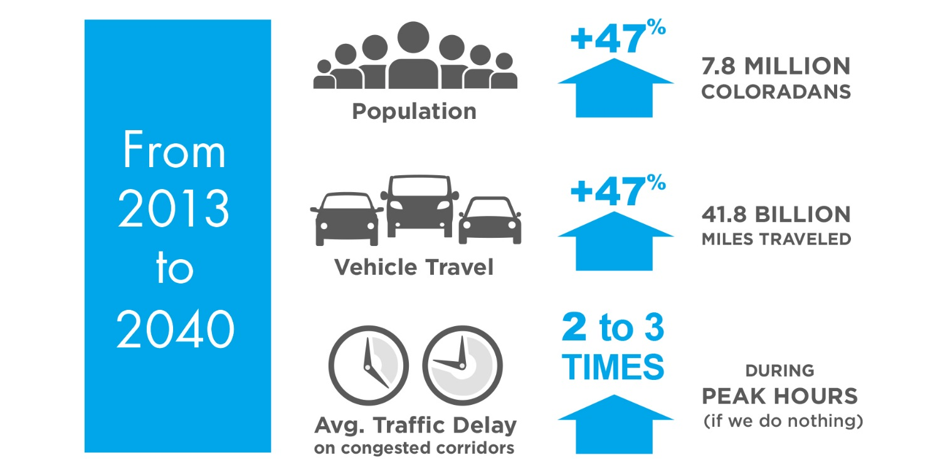
OUR CHALLENGE
continued growth

Slide 8
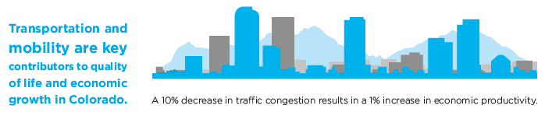

WHY IS THIS IMPORTANT?
transportation impacts us all

Slide 9
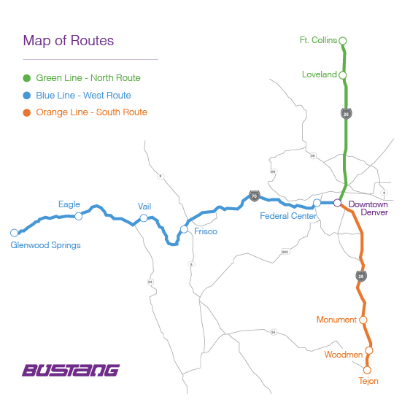
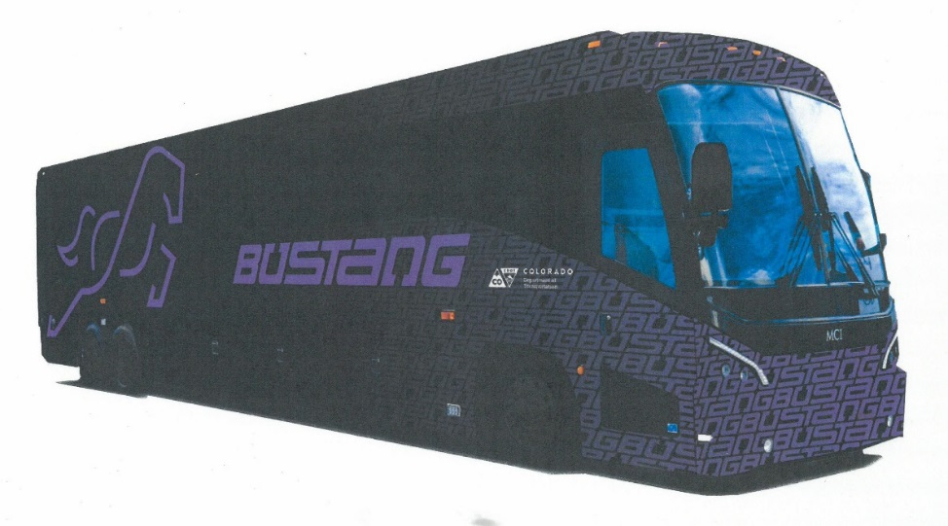
HEALTHY MULTI-MODAL SYSTEM
provides more options
Notes:
Bustang West Route Update
March 2016 Ridership
Total System - 10,057 (first month exceeding 10,000)
West Route - 2,326 @ 74% average daily load factor
Daily (7 days/week) service began in January
Frequent demand exceeding capacity - second bus staged in Frisco
3 new buses ordered for Bustang system additional service
West Route (Vail to Denver) - second run to be added summer/fall
New stops/Park & Ride additions evaluated through SB228 process
Budget limitations prevail
Rural Regional Bus Network Development in process
I-70/Denver - Grand Junction: Partner w/ Greyhound (existing)
US 40/Denver to Salt Lake City: Partner w/ Greyhound (existing)
SH 9/ Steamboat to Frisco: Potential new route

Slide 10

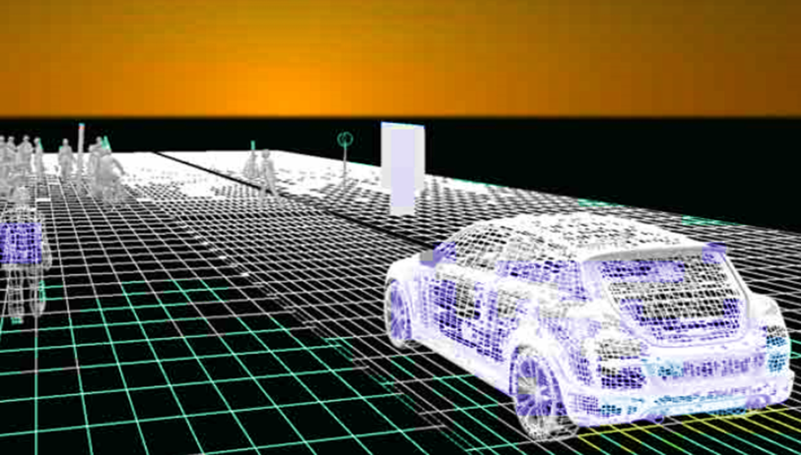
Transforming safety, mobility and transport through technology
Connected vehicles
Big data
Advanced trucking
Smart infrastructure
Notes:
RoadX Video. If you can’t play the video you can switch this slide out for Slide 18.
Note, slides 18-23 provide a bit more detail about the current active projects under RoadX if people ask for specifics, you can jump to those slides to talk about I-70 Connected Vehicles, and I-25 Managed Motorways.

Slide 11

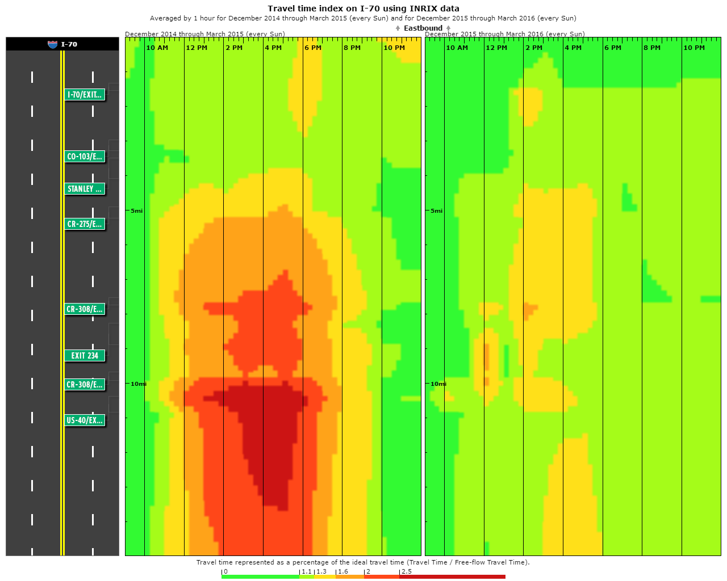
I-70 Mountain Express Lane
Express Lane delivers operational improvements and all lanes benefit
  Compare speeds from 2012 pre-construction to present/Express Lane (2012 – 2016):
    More consistent speeds, clears incidents and we’ve seen overall faster speeds: 26 to 52% reduced travel times
Travel Time Index (EB Sundays on I-70 from MM 228-243-Georgetown to VMT)
MM243
Dec 2014-Mar 2015 (Sundays)
Dec 2015-Mar 2016 (Sundays)
MM228
10AM
10PM
10AM
10PM
Notes:
I-70 Mountain Express Lane -
Jan 2 weekend had record-setting traffic days.
The Express Lane helped reduce overall travel times for all lanes, especially clearing incidents/crashes in the corridor.
EXAMPLE Comparing Martin Luther King Holiday 2012 to 2016 (2012 is pre construction; 2016 is post construction)
MLK 2012 at 4 p.m. travel times in all lanes = around 23 minutes
MLK 2016 at 4 p.m. travel times in all lanes = around 17 minutes
RESULTS → REDUCED TRAVEL TIME 26 % (BY 6 MINUTES)
MLK 2012 after 7:30 p.m. travel times in all lanes was and 17 to 33 minutes
MLK 2016 after 7:30 p.m. travel times in all lanes was 14-16 minutes
RESULTS→ REDUCED TRAVEL TIMES AS MUCH AS 52 %
Factoids:
Opened Mid-December 2015 (Dec. 13, 2015)
Only closed one day due to snowstorm (12/12/15 – the original opening day)
Toll price around $6
Open 73 days a year: weekends and holidays. Won’t be open in mud and shoulder seasons
Eager to see how lane performs w Summer traffic – which is heavier than winter, and we see more RVs and trailers on the corridor
Some other talking points
Planning Time for EB I-70 on Sundays last winter averaged 119 minutes to arrive on time (53 minutes free flow)
Planning Time for EB I-70 on Sundays so far this winter averaged 66 minutes to arrive on time, a 19% decrease savings of 53 minutes...a HUGE increase in travel reliability

Slide 12
Looking Ahead
S.B. 09-228 (~$200/year for five years, beginning this year)
        Received first full transfer on June 30!
        Scheduled to receive a ¾ transfer on June 30, 2017
        Making the Hospital Provider Fee (HPF) a statewide enterprise, or providing another mechanism to eliminate refunds (such as Prop 117) would allow SB-228 funds to flow
Bonding
        CDOT is receptive to bonding, but needs a stable additional revenue source to pay for the bonds
What Can You Do?
        Support enterprise status to the HPF to help transportation and the General Fund
        Support new funding for transportation to pay for any new bonding proposal
        Support Prop 117 or other mechanism to allow the state to retain collected taxes
Notes:
Notes

Slide 13

QUESTIONS?
Notes:
NOTES
CDOT continues to strive towards being the best DOT

