Slide 1
Peak Academy
@DenPeakAcademy
Brian.Elms@denvergov.org
720-913-1645
www.denvergov.org/peakacademy

Slide 2
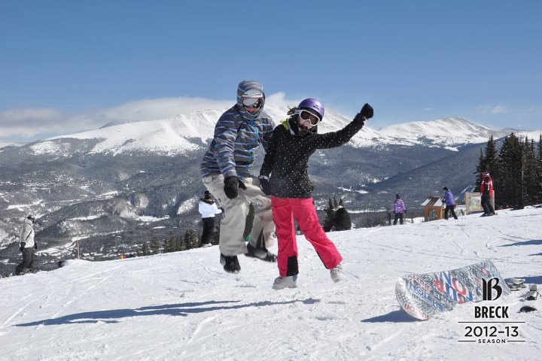
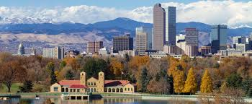
I’M BRIAN, I’M FROM DENVER

Slide 3
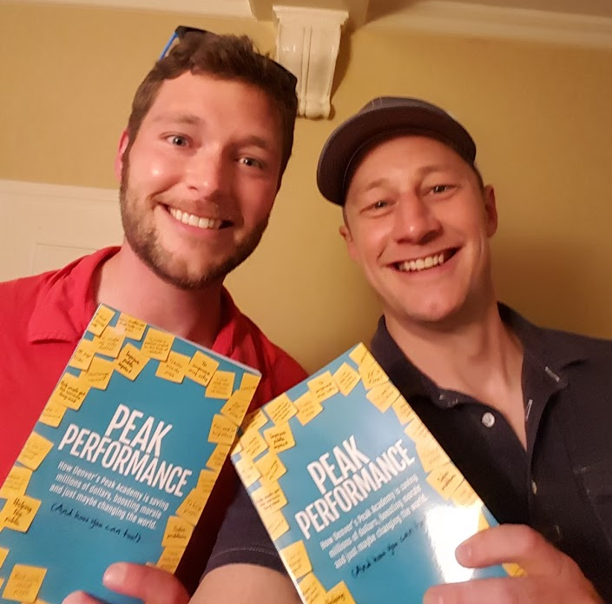
What Is Peak Academy?

Slide 4
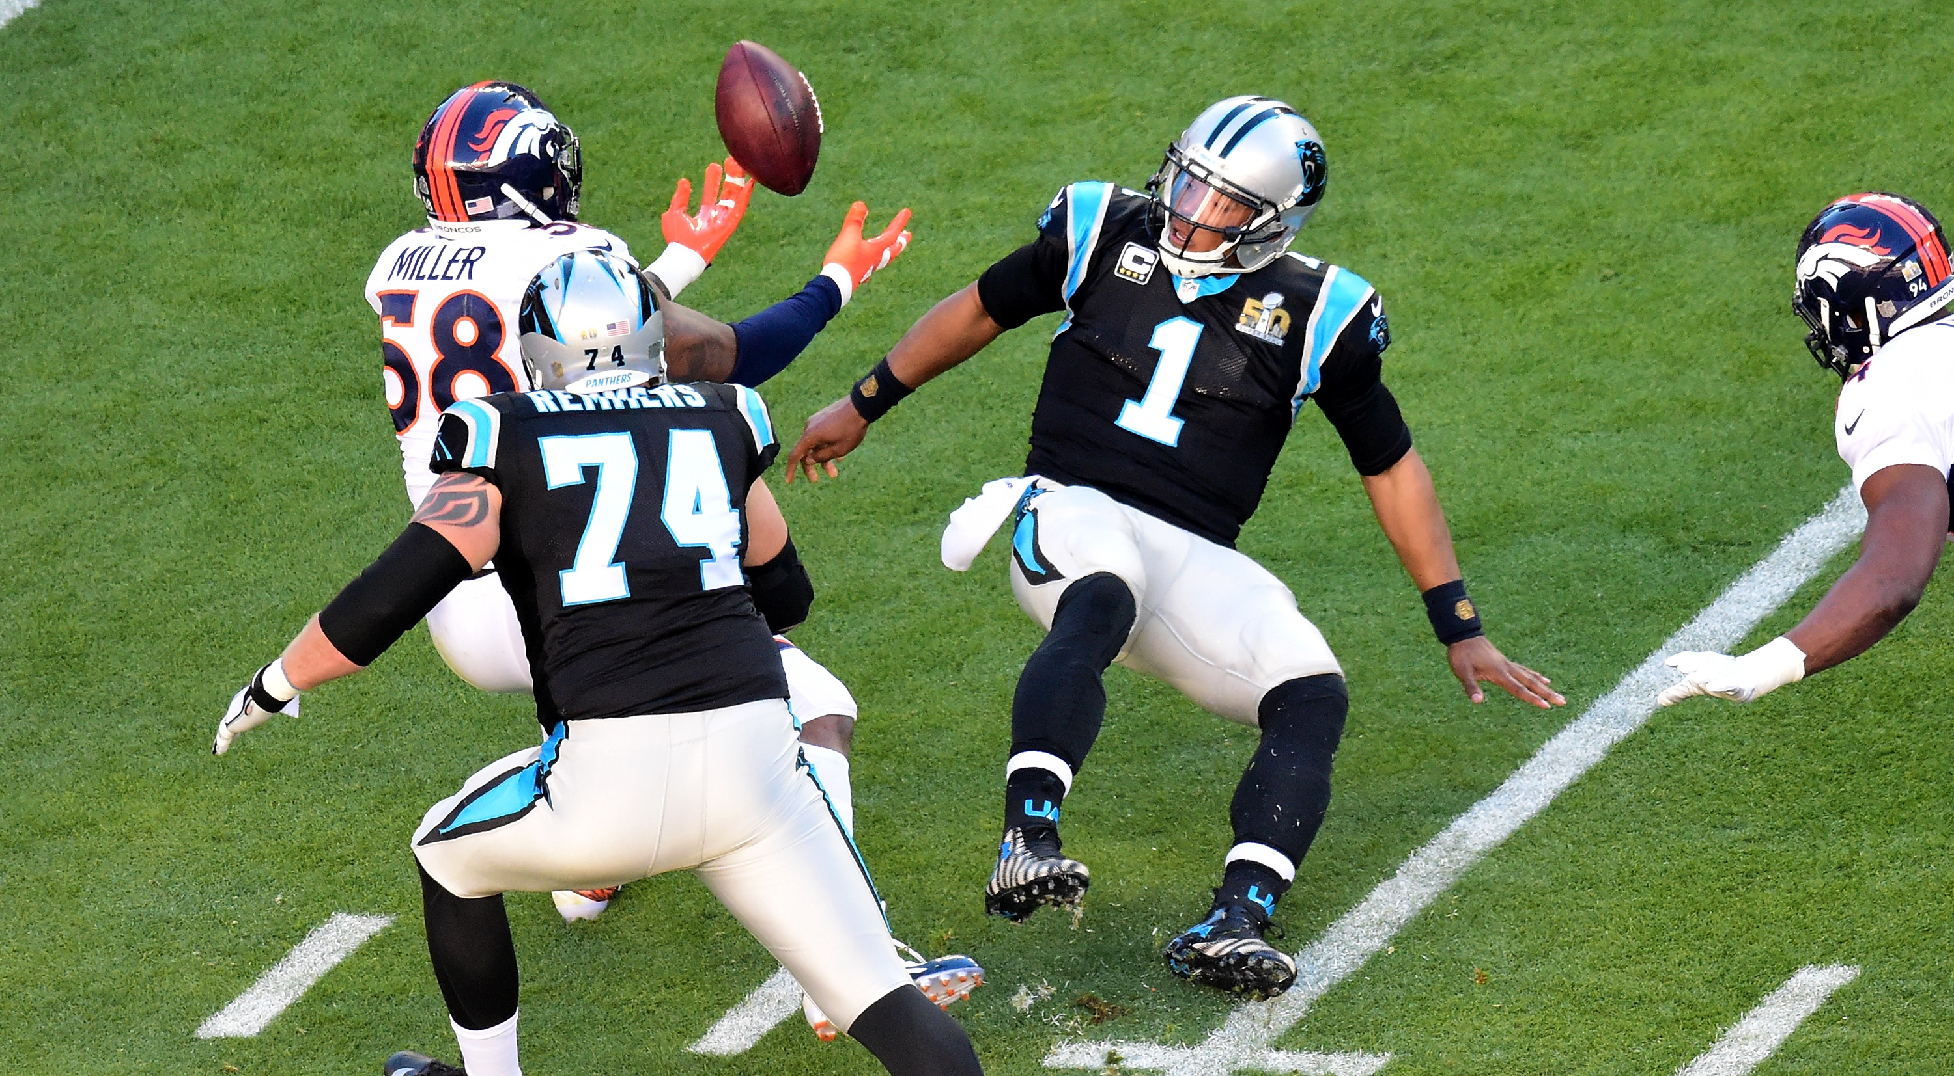
Do you really do that?

Slide 5
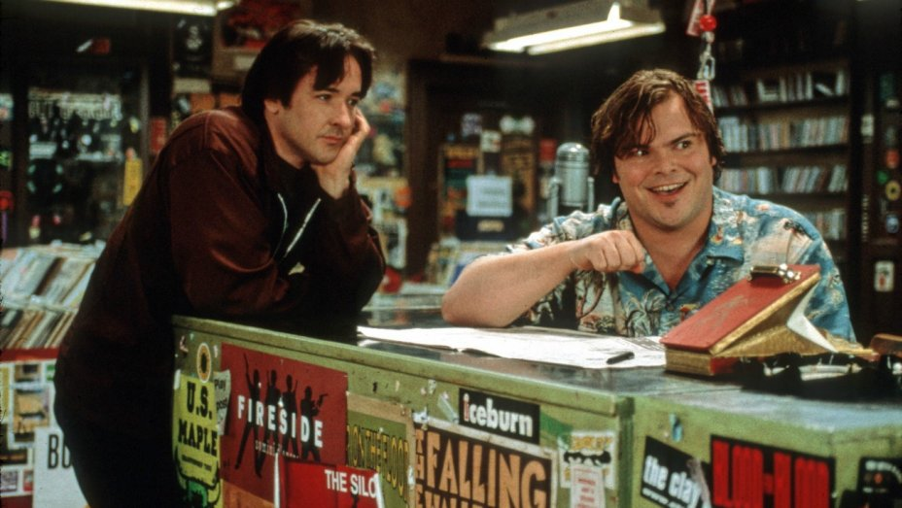
Stories are more fun!!!!

Slide 6
Getting to work

Slide 7
How People Get to Work

Slide 8
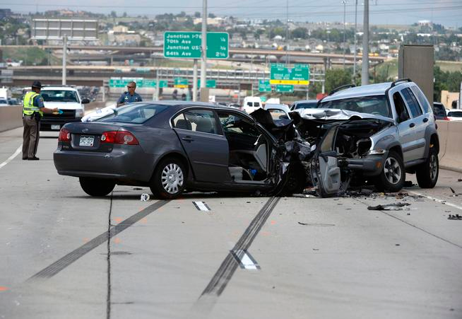
Getting to work can be terrible

Slide 9
What Do the Crashes Actually Look Like?

Slide 10
Hot Spots

Slide 11
Intersections with high amounts of accidents

Slide 12
Fatalities

Slide 13
What can you do to help?

Slide 14
The Case for Never Turning Left

Slide 15
STOP TURNING LEFT!!!!
We could save lives by restricting left turns, but we’re unwilling to sacrifice what we see as a needed convenience. Even if you discount the safety concerns, the efficiency of turning left is questionable.

Slide 16
What Makes Denver Different

Slide 17
Increase the Capacity to do more Good

Slide 18
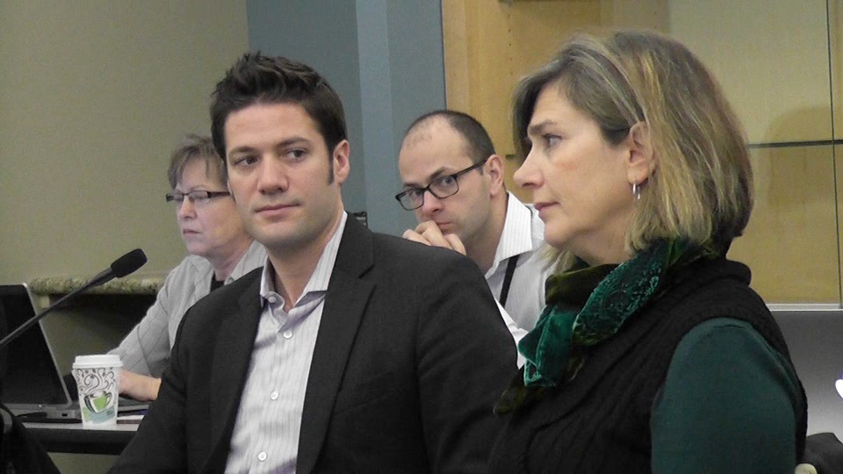
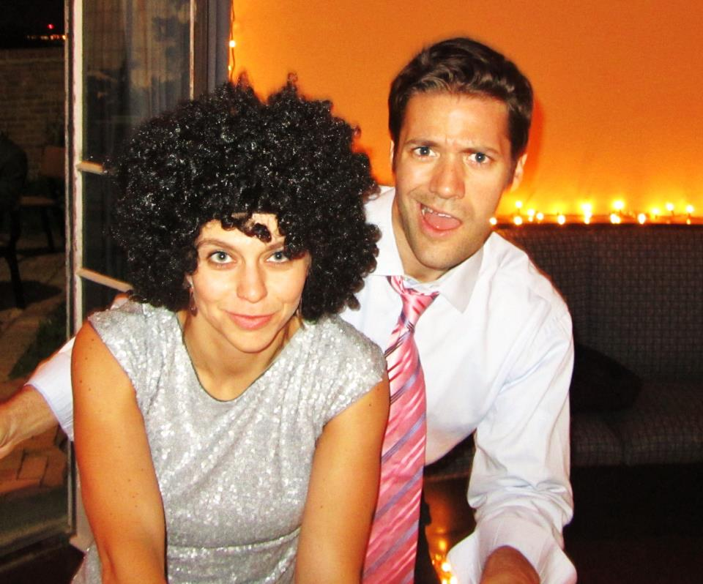
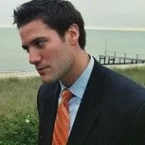
David Padrino’s Happy Face

Slide 19
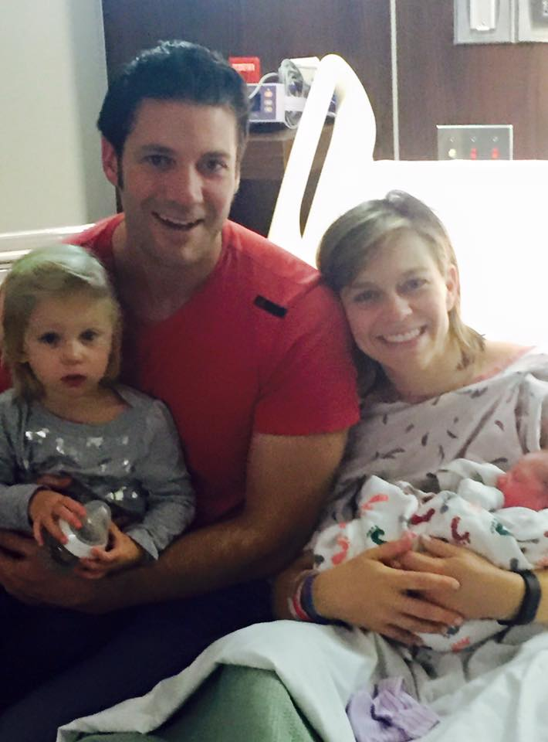
Actual Happy Face

Slide 20
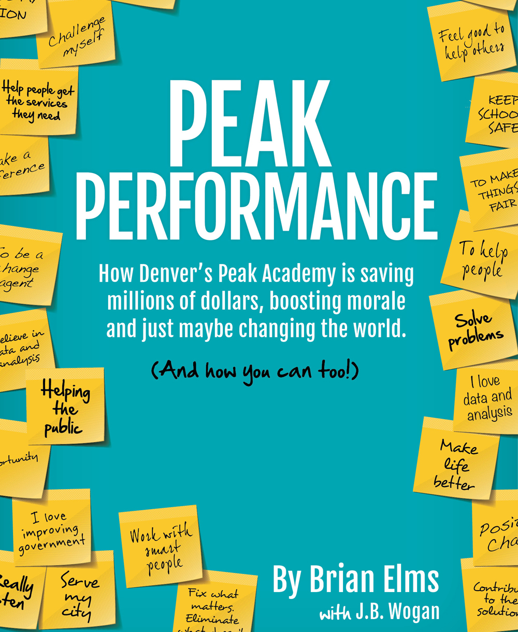
Book can be purchased on Amazon

Slide 21
WRAP UP
Questions?
Contact Information
Brian.elms@denvergov.org
720.913.1645
@denvpeakacademy
Learn more about Peak Academy in…

Slide 22
Video Bonus

