Slide 1
Colorado State Government: Performance Management Overview
Results Driven Government session for Impact Denver
David Padrino, Chief of Staff to the Lieutenant Governor
& Deputy Chief Operating Officer
July 26, 2016
Notes:
Good morning everyone, my name is David Padrino and I’m the COS to the LG and the state’s Deputy COO. I’m happy to join you today to talk about how the state promotes a culture of customer focused operational excellence throughout all our operations.

Slide 2
Let’s get one thing out of the way up front
Brian is more fun than me…
And I haven’t written a book
Notes:
But first, let’s make one thing clear. Brian will be much funnier than me. And I haven’t written a book….. Sorry…

Slide 3
Context
$27B conglomerate (Fortune’s top ~120) with 19 principal departments
~30,000 person workforce
Constitutional and legislative controls on spending priorities and revenue
Era of “do more with less”
Notes:
Okay, let me set the stage with some basic background (read bullets)

Slide 4
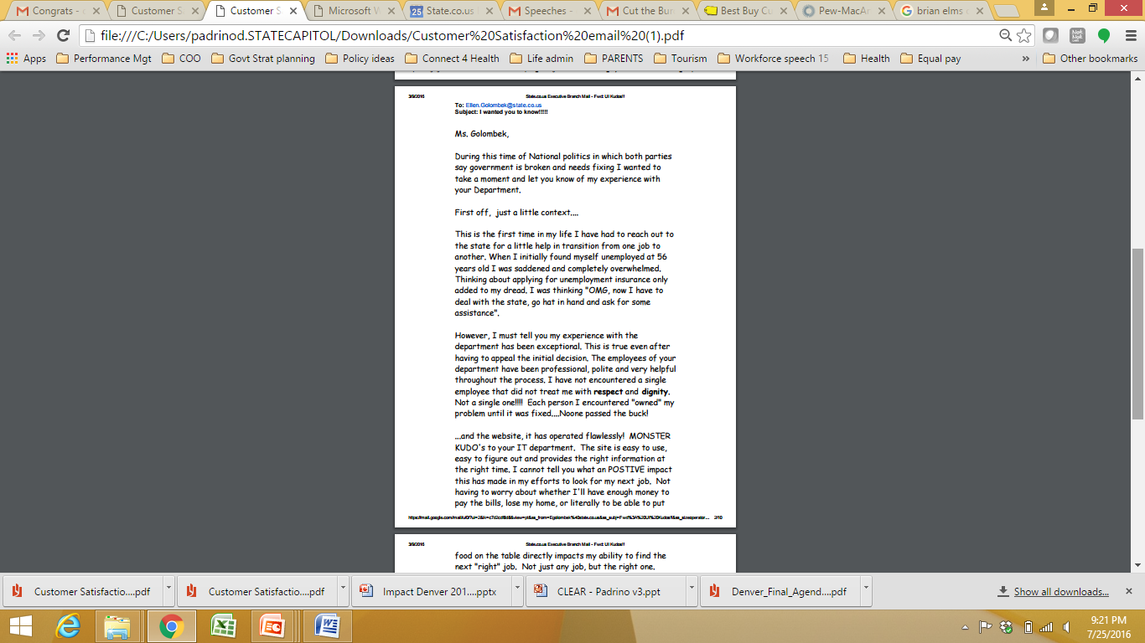
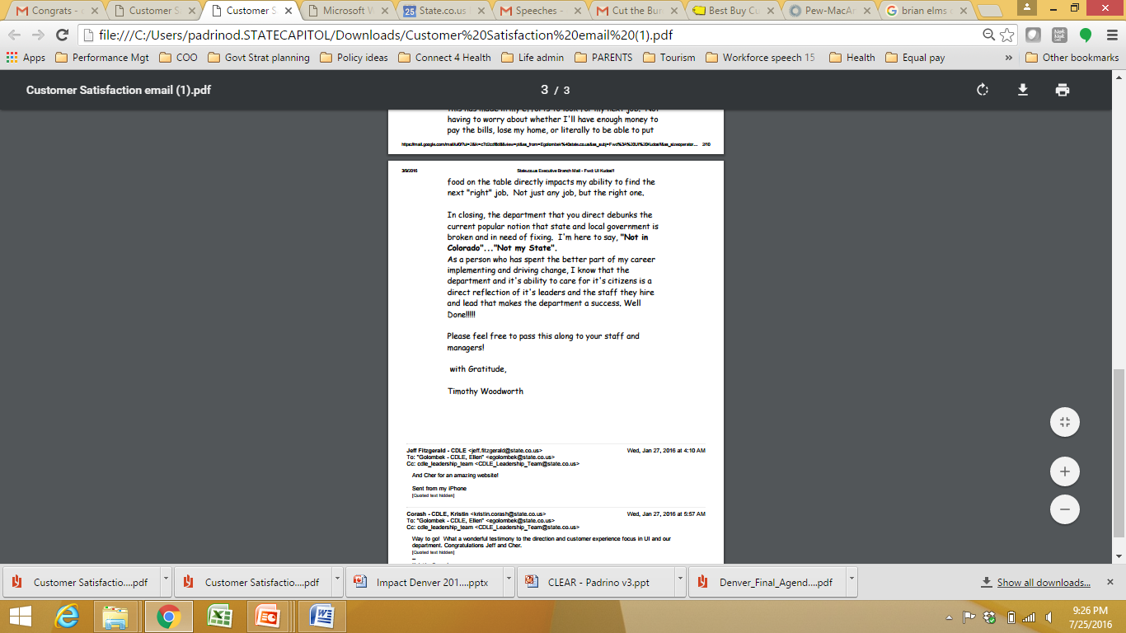
Why do I wake up in the morning?
Notes:
Before we go further… why are we doing any of this work?
It’s b/c of letters like this, from a despondent customer who sought unemployment insurance, and was treated so well, he told us “the department you direct debunks the current popular notion that state and local government is broken and in need of fixing”

Slide 5

Performance Management Framework
Key Program Elements
Vision
& Values
  Administration strategic planning
  Department Performance Plans
  Department, Administration and Cabinet member goal alignment
What are our priorities?
Admin-istration goals
Department
Performance Goals
How will we achieve them?
Governance, Planning & Execution
  SMART Act legislation
  Cabinet working groups
  Perf. Mgt team support for Depts.
How will we know we are successful?
  Administration results dashboard
  SMART Act reports
  Results First
Reporting & Evaluation
How do we make it last?
  Statewide Lean program
  Performance Management Academy
  Employee engagement support
Customer-focused Culture
Promoting a culture of customer-focused operational excellence across state government
Notes:
This is the framework that guides and integrates our work. The frameworks ensures we answer 4 critical questions: What are our priorities? How will we achieve them? How will we know we are successful? And how do we make it last?
There are 3 major pillars of work here, and I’ll address each – performance management, our lean program, and capability development and employee engagement

Slide 6
Four components of a culture of customer-focused operational excellence
Results focused – customer value creation, measure what matters
Organizational alignment – clear goals understood by all, operations drive towards long term vision
Continuous process improvement – consistent emphasis on making processes more efficient and effective
Engaged employees – employees who are ready (understand their role and goals), willing (motivated to support the vision) and able (have the skills / authority to do the job)
Notes:
And here are the four elements of a high performing organization, which supports the customer focused culture of operational excellence we’re looking for.
I share this one in particular b/c it might be useful for you all as you think about what’s needed to improve the organizations in your lives.

Slide 7
Goals, metrics, plans, meetings – basic but necessary
The nuts and bolts of managing government performance
Notes:
Okay, the basics of managing performance in government is about goals, metrics plans and meetings
Sounds boring, but you need to have definition of success and leadership decision making system to help you drive towards it.
These are the nuts and bolts of our machine.

Slide 8
Lean program: working towards embedding continuous improvement in the culture
Notes:
Our lean program is focused on driving continuous improvement of all our processes – by putting the tools to fix problems in the hands of as many state employees as possible

Slide 9
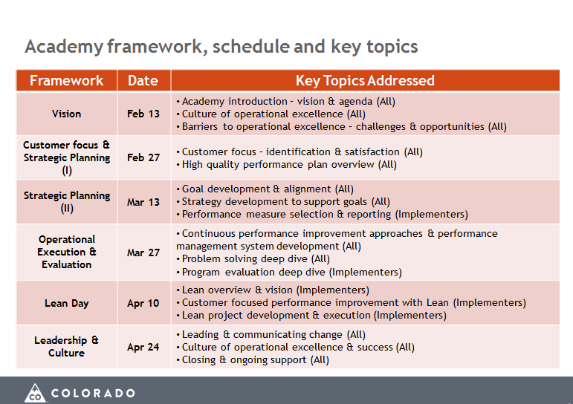
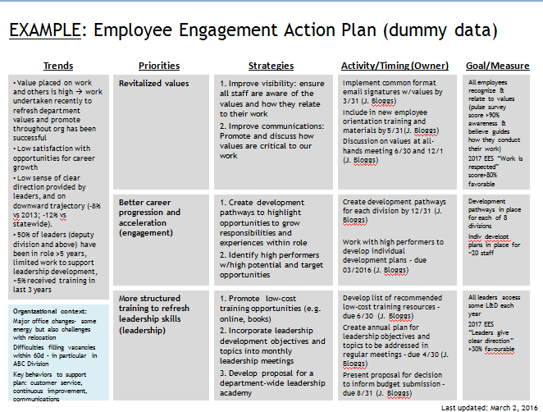
Capability building and employee engagement
Notes:
And our third pillar is around our Academy, which is about teaching people to fish – or in this case do strategic planning – and our employee engagement effort, which is about working with departments to build a plan to build engagement based on what’s working across the state.

Slide 10
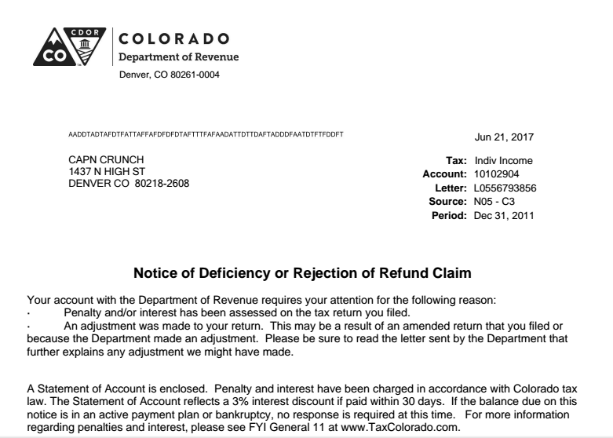
Example 1: Behavioral Economics, or:
How do we make it more likely that Cap’n Crunch will pay his taxes on time?
Notes:
Now, to some examples.
We’re launching a pilot soon using behavioral economics to update the letter sent to late income tax filers. By adding just one sentence – “did you know 90% of people in your neighborhood file on time” – we hope to see big results. Why?
BE TIMELY HERE – TRANSITION.

Slide 11
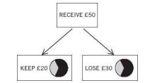
Quick: which do you prefer?
Source: Kahneman, Thinking Fast and Slow
Notes:
Quick – you receive $50… would you rather keep $20 or lose $30?
They are the same outcome of course, but behavioral economics tells us people hate losses more than they love gains. This is just one of the findings that drives this new field of applied research.

Slide 12
Now that’s a big number
5%
Notes:
And why bother with all this?
B/c when a team in the UK made similar adjustments to letters, they increased payments 5%, driving tens of millions more pounds into the coffers than they would have otherwise received.

Slide 13
Example 2: Results First, or:
What if tested whether or not our programs deliver real ROI?
Program Inventories
Benefit Cost Model
ROI
+
=
Notes:
Second, let’s talk about Results First.
This is our initiative with Pew-MacArthur that says, wouldn’t it be great to know if your programs are providing a positive return investment?
Basically, we tested evidence based programs in 3 areas using a model that incorporates CO specific costs

Slide 14
What we found (I)
Adult Criminal Justice programs
  21 assessed: Prison, Parole, Community Corrections, other Community Treatment
    13 with + ROI; 8 with – ROI
Juvenile Justice programs
  8 assessed: DYC Facilities and Parole
    7 with + ROI; 1 with – ROI
Child Welfare programs
  4 assessed, all with + ROI
Notes:
You can see we looked at programs across criminal justice, juvenile justice and child welfare.
And what we found is that plenty of programs have a positive ROI, but some do not.

Slide 15
What we found (II)
Additional learnings
  Limitations in identifying data on state-funded programs
  Limited to no research available on effectiveness
  Although certain programs are evidence-based, issues with fidelity remain
Notes:
We also found other challenges to making these program more cost effetive.
The next step isn’t to just end these programs – but to find out why they’re not working as they should, something that would have been much harder to detect without the Results First work

Slide 16
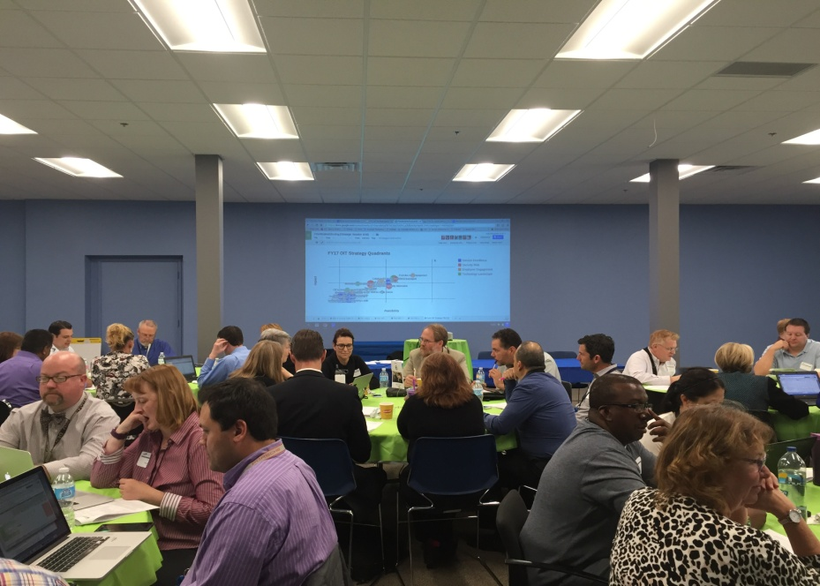
Example 3: Performance Management Academy, or:
Wouldn’t it be great to give people the skills to drive the change we want to see?
Notes:
Our performance management academy is a 6 day session for top state leaders to become better at building and implementing strategic plans.
We have a highly structured curriculum, bring in outside speakers, and provide tools that leaders can use to improve performance.
For your purposes, the academy is important b/c if any of you want to make change in large organizations or systems, you’ll need to think about capability building.

Slide 17
Is it working?
“I’ve been in state government for over 20 years, and the Performance Management Academy is the best professional development opportunity I’ve ever gotten. I am really inspired by your focus on the customer and on results.” his is the best professional development experience I’ve ever had. Thank you.”
  - 2016 Academy attendee, CFO for department with multi billion budget
Source: Academy attendee survey 2015 and 2016
Notes:
Okay, but is it working?
Here you see 80% of people in our last Academy saying their comfortable with our concepts and tools, and 100% of them would recommend the Academy to a peer.

Slide 18
Is it really working?
Source: Performance Management Team analysis
Notes:
But that is just the front of the chain… we want to drive more impact on quality plans
Here you see how plan quality has improved substantially since the launch of the Academy

Slide 19
Is it really working on things that matter?
Goal | 2014 Baseline | 1 Yr Goal | 2015 result | 2016 YTD
Improve customer service excellence rating | 56% | 73% | 70% | 93%
Reduce information security risk across departments (index) | 18.4 | 16.6 | 15.4 | 9.7
Increase employee engagement | 56% | 58% | 62% | 67%
Notes:
And seriously what really matters are results for citizens.
Here you see how one of our major departments has been able to take lessons from the Academy and turn that into results like reducing the security risk index across departments by almost half in just a couple years.
The Academy is not the cause for all of this, but it is a critical and I’d argue necessary ingredient

Slide 20
Back to our opening story
Notes:
Alright, let’s wrap this up by going back to our opening story.
Let’s call this customer Joseph, who found himself unemployed at 56 and overwhelmed by the prospect of getting unemployment insurance and dealing with “the state”

Slide 21
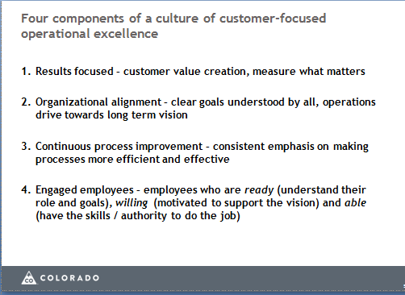
What did the department do?
Notes:
Little did Joseph know that years ago, when the department’s satisfaction ratings were around 50%, they started making changes and investments aligned to the four elements here.
They started measuring and prioritizing customer satisfaction and internal employee engagement. They launched a number of Lean initiatives. And the leadership made it clear that these were priorities.

Slide 22
Notes:
And now just read Joseph’s words yourself

Slide 23
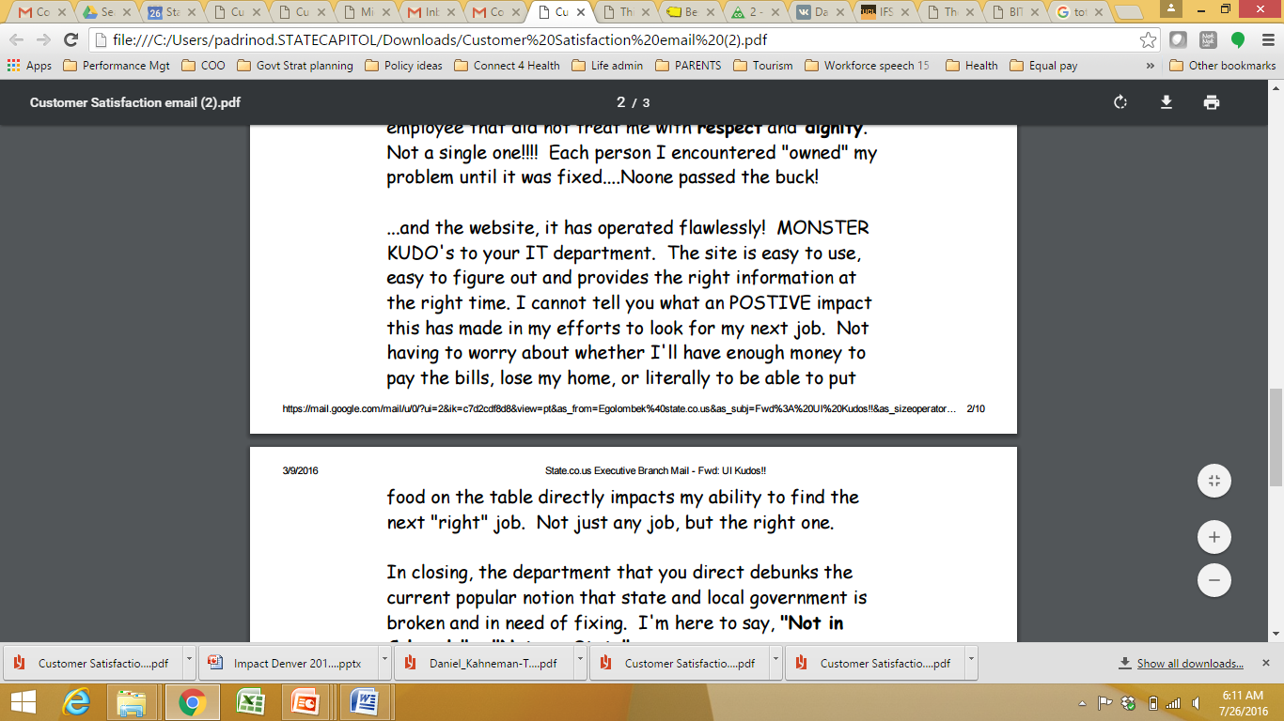

Slide 24
Notes:
Give time to read
Today, customer satisfaction is above 95%. I hope this, and Joseph’s story, makes you as happy as it makes me.

Slide 25
Group Exercise – Logic Tree

Slide 26
A logic tree can help you think through how to achieve your goals
Logic tree: A problem solving tool that breaks a problem into discrete chunks to identify the logical relationships and exhaustive possible paths to address the problem
Why use logic trees in general?
  To break a problem into component parts
  To take a consistent and comprehensive approach to problem solving
  To build a common understanding and approach to problem solving within the team
  To help focus team efforts
  How does a logic tree help me think through how to achieve my goals?
  The base “problem” should be framed – why the goal is needed
  As you break this down from left to right, you will address different potential approaches – strategic choices
  Then, you can prioritize which strategies or “branches” along the tree have the best combination of impact and feasibility
  Select the activities to implement strategies – specific operations (programs) and processes (activities)
Sub-issue
Issue 1
Sub-issue
Sub-issue
Issue 2
Sub-issue
Problem or Goal
Sub-issue
Issue 3
Sub-issue
Issue 4
Sub-issue
Issue 5
Sub-issue

Slide 27
Example logic tree
Food
Clothing
Buy fewer items
How could you reduce your expenditure each month?
Entertainment
Travel
Buy lower-quality items
Pay less for same quantity of items
Buy items at discount/on sale
Share costs of items (e.g., split rent with roommate, car pool)

Slide 28
Colorado State Patrol Logic Tree Example
Strategic choices
Programs
Operations
Trooper scheduling & deployment
Highway supervision
Enforce laws around the most dangerous driving behaviors (HVPT, DUID, seat belts)
Highway patrolling
DUI / DUID checkpoints
How do we...
Reduce the number of fatal & injury crashes from 3,725 to 3,166 by 2018 for highway users under the CSP’s jurisdiction?
Trooper education
Recruitment & Training
Enhance public awareness around the risks of dangerous driving behaviors
Public education & outreach
Community visits
Trooper scheduling & deployment
Enforcement
Implement primary seat belt legislation
Highway patrolling
Public education & outreach
Media campaign

Slide 29
Your turn
Think about a goal you are working on in your personal or professional life (make it a goal you are ready to talk about with someone else)
Take 10 minutes to work on a logic tree for that goal
Share with a partner and get feedback on what you’ve put together
We’ll pick a few groups to talk about what was difficult, helpful or interesting about this exercise

